Slide 1
Party planner
Group X7 – Year 2010/2011 – First Year Team Project

Slide 2
Introduction
What is Party Planner?
Social event planner for you and your friends
How does it work?
Allows you to plan your party or randomise the entire event
Why is it useful?
Ideas for themes and venues
Offers from various venues

Slide 3
Look and Feel
Several important pages
Home page
Account pages
Help page
About us
Legal pages
Party selector (main feature of the website)

Slide 4
Flow Diagram
Home Page
Login
Account
About Us
Venues
Personal Details
Friends
Party Planner
Contact Us
Information
Catering
Dress Code
Legal

Slide 5
Main Template
Template

Slide 6
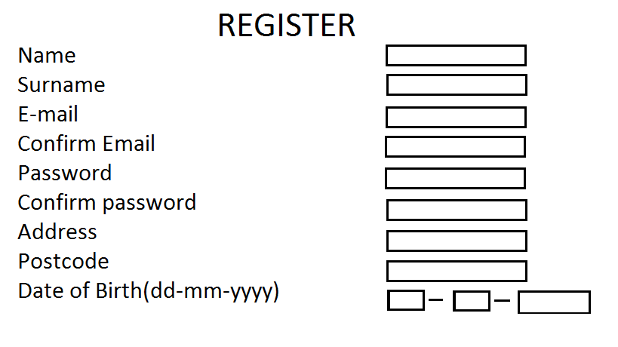
Registration Form Idea

Slide 7
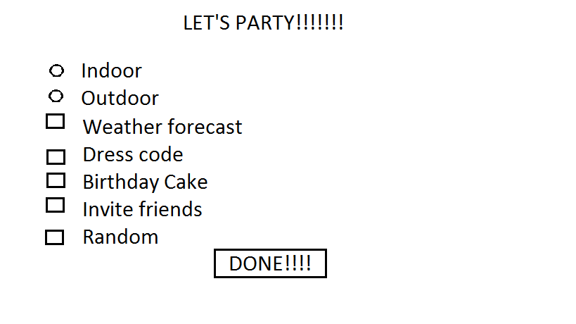
Party Selector Forms

Slide 8
Technologies
Use of HTML and CSS
Used for main layout and design
PHP and MySQL
Interactivity between the user and the website
JavaScript

Slide 9
Party Planner Databases
Dress Code
CREATE TABLE IF NOT EXIST `Dress_Code` (
`Id` int(11) NOT NULL,
`Name` varchar(20) collate utf8_unicode_ci NOT NULL,
`Description` text collate utf8_unicode_ci NOT NULL,
PRIMARY KEY (`Id`)
) ENGINE=MyISAM DEFAULT CHARSET=utf8 COLLATE=utf8_unicode_ci;
Venue
CREATE TABLE IF NOT EXISTS `Venue` (
`Id` int(11) NOT NULL auto_increment,
`Name` varchar(40) collate utf8_unicode_ci NOT NULL,
`Address` text collate utf8_unicode_ci NOT NULL,
`City` varchar(20) collate utf8_unicode_ci NOT NULL,
`PostCode` varchar(8) collate utf8_unicode_ci NOT NULL,
`Phone` bigint(20) NOT NULL,
`Email` varchar(60) collate utf8_unicode_ci NOT NULL,
`CostPP` int(11) NOT NULL,
PRIMARY KEY (`Id`)
) ENGINE=MyISAM DEFAULT CHARSET=utf8 COLLATE=utf8_unicode_ci AUTO_INCREMENT=1;

Slide 10
Ethics and Security
Ethics put user first
Our priority is to maintain safety of user information
All information about the user should be kept private
Website should be easy to use by the user
Ease of access

Slide 11
Ease of Access
Able to be used by people with disabilities
HTML tags
W3C Checklist
http://www.w3.org/TR/WAI-WEBCONTENT/full-checklist.html

Slide 12
Security
PHP POST vs GET
Password encryption
MD5
User security
Automatic log out
IP tracking
Keep a log of activity
Admin accounts
Lock failed login attempts
Database security

Slide 13
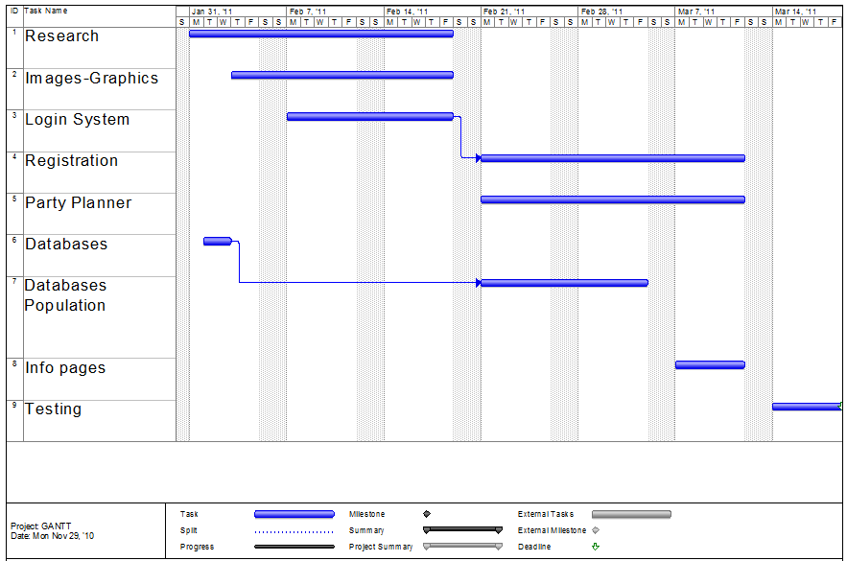
Time Management

Slide 14
Conclusion
Allow parties to be planned easily
Use of multiple technologies
We will ensure user privacy

Slide 15
Questions?

